Slide 1

Joins and binds
Combining two datasets

Slide 2
Add separate and unite for column level things

Slide 3
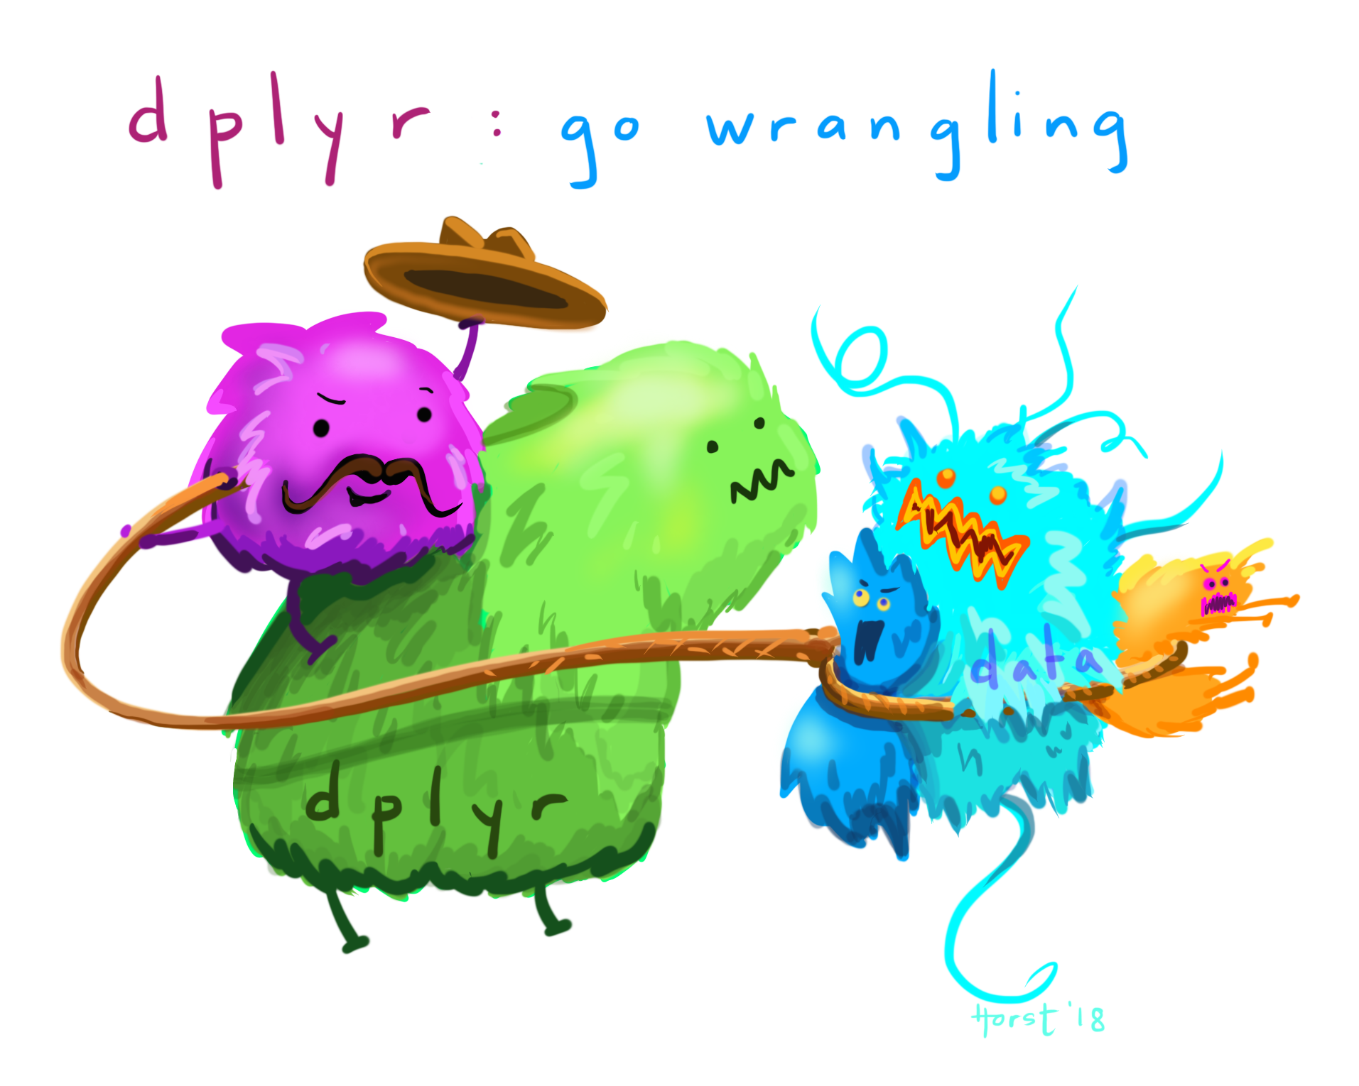
Back to dplyr!

Slide 4
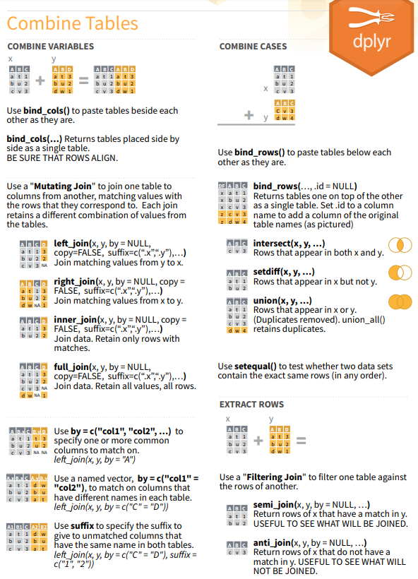

Slide 5

*_join (combines variables/fields)
Combine tables that contain different information, but share a KEY
left_join
inner_join
full_join

Slide 6
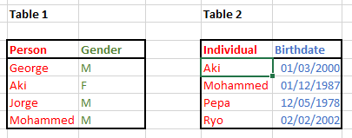
What if the Keys don’t match?
Option 1 – Change column names so they are the same
Using select()
Using rename()
Option 2 – Explicitly specify by= c("Person" = "Individual")

Slide 7

Question
Wait… so how did it know the key before?
Implicit inputs! Check the warnings!

Slide 8
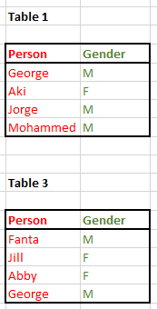
Bind_rows (combines observations)
Suitable to combine similar data from different events

